Slide 1
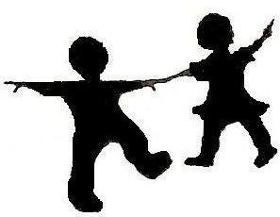
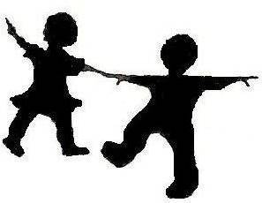

FLESFEST 2018
FLESQUEST
30th
ANNIVERSARY!
Celebrating Our Progress;
Charting Our Future
Together!
Network: AlvernoGUEST
UserID: eventguest
Password: alverno18
To access Wi-fi:

Slide 2
Another Important C:
Celebration!
Josh LeGreve
Green Lake Schools
joshlegreve@gmail.com
FLESFEST 2018

Slide 3

We all know
the five C’s
Collaboration
Cooperation
Celebration!
Creativity
Challenge
Critique

Slide 4


FLESFEST
30 Years!
“Every day is a good day. There is something to learn, care, and celebrate.”
-Amit Ray
“In our work and in our living, we must recognize that difference is a reason for celebration and growth, rather than a reason for destruction.” -Audre Lorde
“The more you praise and celebrate your life, the more there is in life to celebrate.”
-Oprah
“Singing is like a
celebration of
oxygen.”
-Bjork
Now’s the time for us
to celebrate!
What is celebration?

Slide 5
Celebration is universal.
Celebration is essential.

Slide 6
Celebration is SURVIVAL.
Celebration is ADVOCACY.
Celebration is GROWTH.

Slide 7
Celebration is...
Survival.

Slide 8
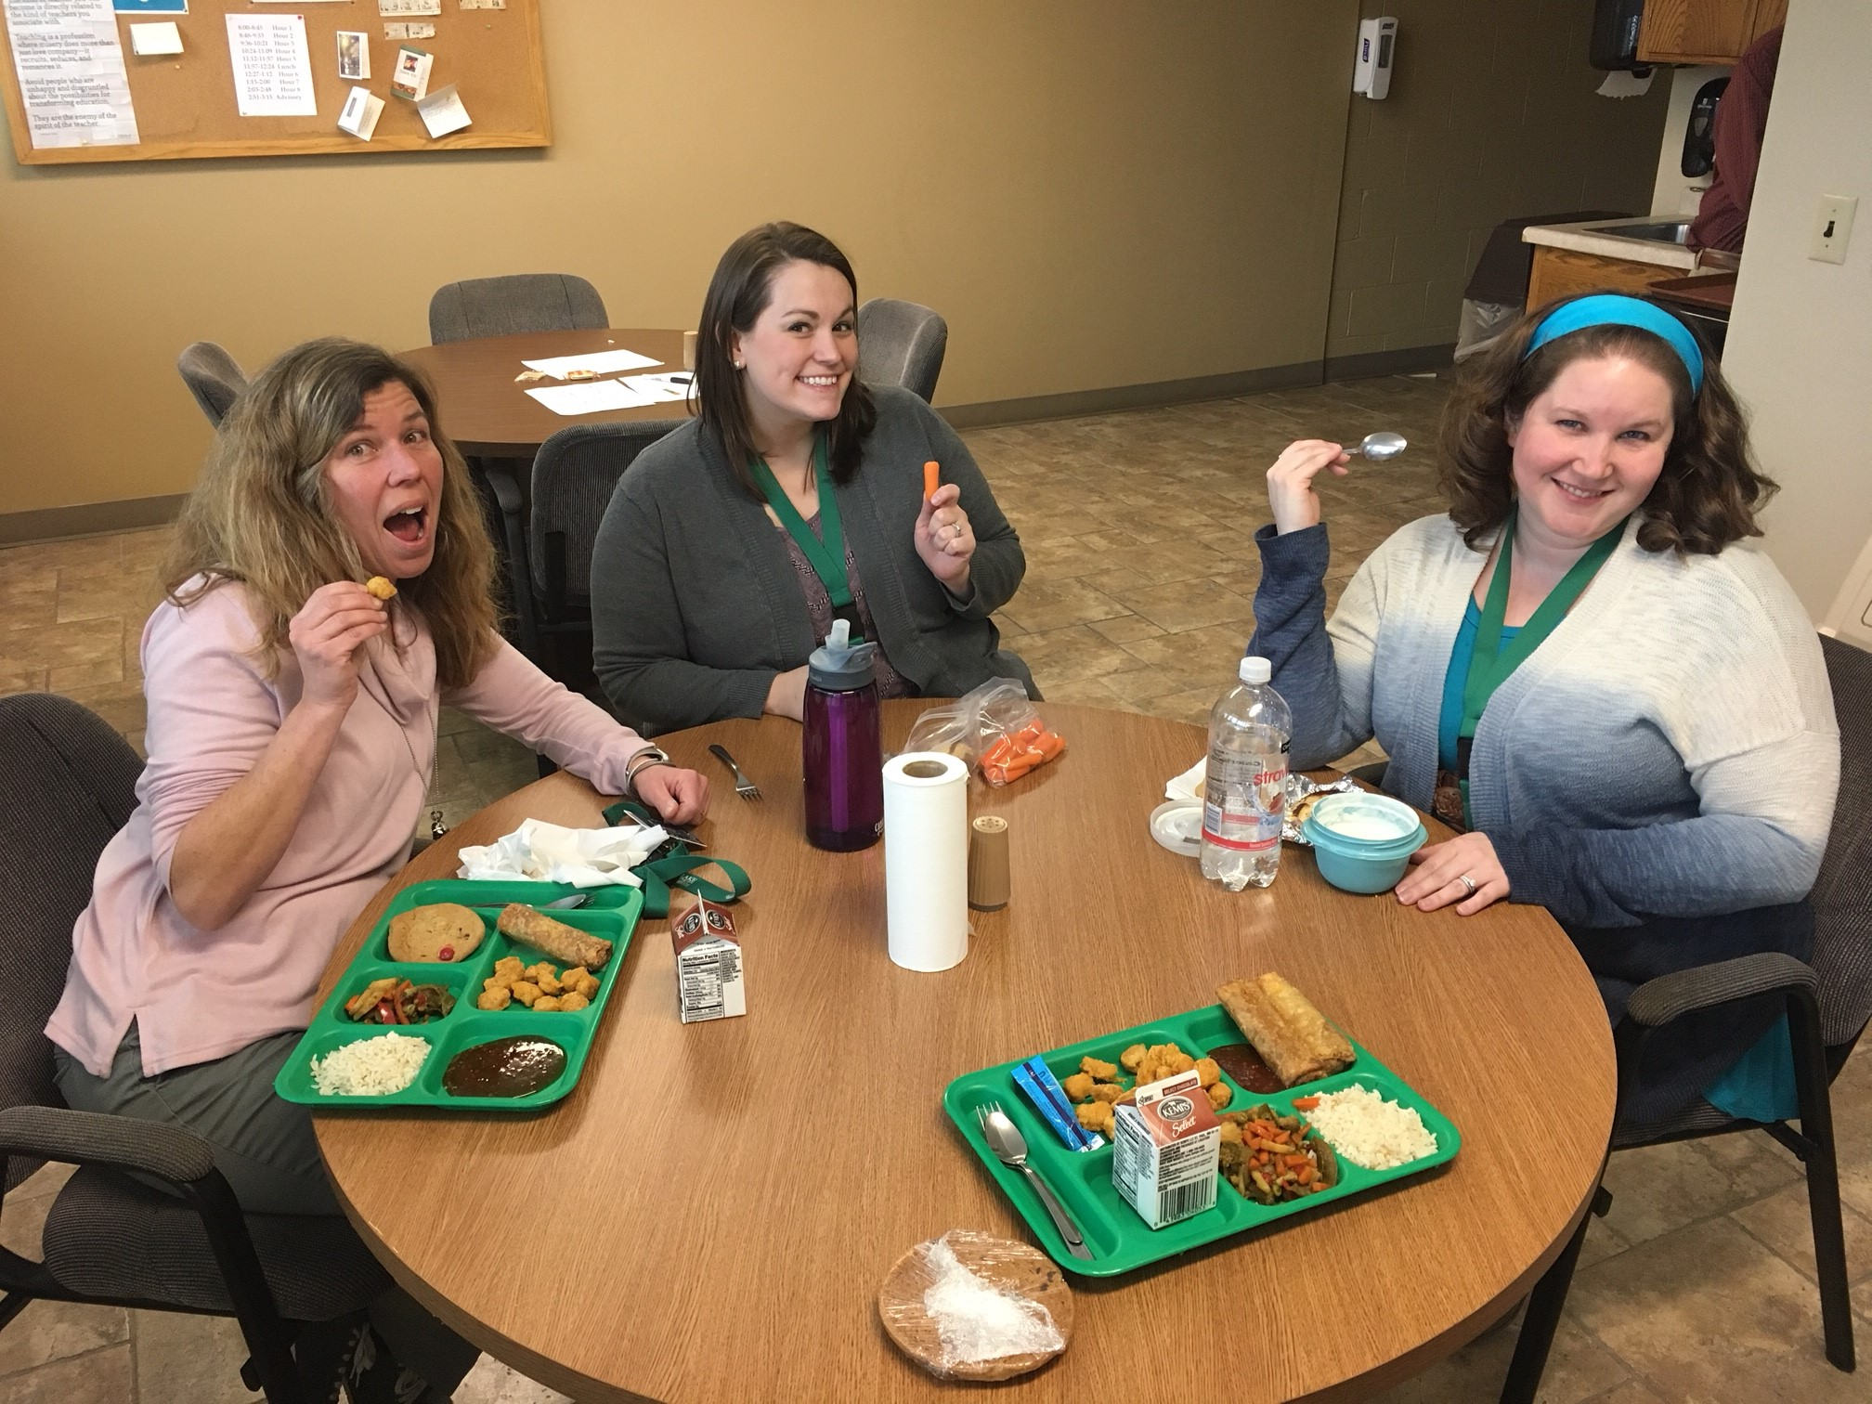
My
Lunch
Bunch

Slide 9
“Social Lubrication”
According to Stephanie Harvey & Harvey Daniels, Comprehension and Collaboration
“Off task” social behavior is natural human routine
Task work vs. Maintenance
Needed for smooth working in small groups.

Slide 10
Let’s Celebrate
Alone
On your hand out, think about everything that has happened in the last week. Write down one celebration, no matter how small you may think it is, and wait for next instructions.
With one partner
Find one other person you do not know yet. In this group of 2, share your name, what and where you teach, and your celebration.
Two pairs together
As a pair, find another group and join together. Take turns introducing each other. You must share your partner’s information with the other group.

Slide 11
1-2-4 Group Strategy
This strategy is great for tasks where participants might be (a) reluctant to answer or (b) have too many answers
Builds in wait time (alone)
Builds confidence by checking with small group before the large group
Makes more people comfortable contributing to the large group.

Slide 12
1-2-4 Group Strategy
Take a moment to reflect on your handout.
How can you/Do you use 1-2-4 in your classroom?

Slide 13
One day with my lunch bunch…

Slide 14
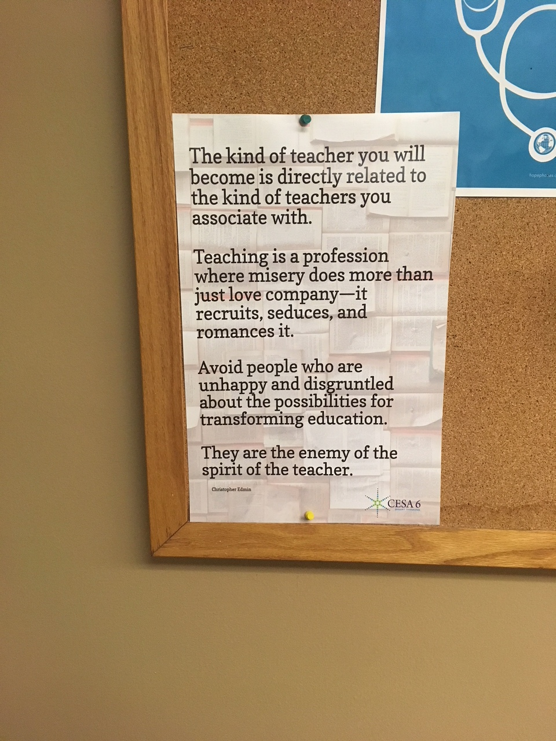
“Teaching is a profession where misery does more than just love company — it recruits, seduces, and romances it.”
What am I doing to prevent this!?
-Christopher Emdin, For White Folks Who Teach In the Hood…And the Rest of Y’all

Slide 15
5 minutes
1-2 thoughts
Changes focus
Gratitude Journaling
That’s not that much time
That’s not too difficult, even on the tough days
to positivity and the good moments.

Slide 16
October 12, 1996
Who’s journal is this?
1. A run around Florida’s Fischer
Island with a slight breeze.
2. Eating cold melon on a bench in
the sun.
3. Maya Angelou calling to read me
a new poem.
4. A long and hilarious chat with
Gayle about her blind date with
Mr. Potato Head.

Slide 17
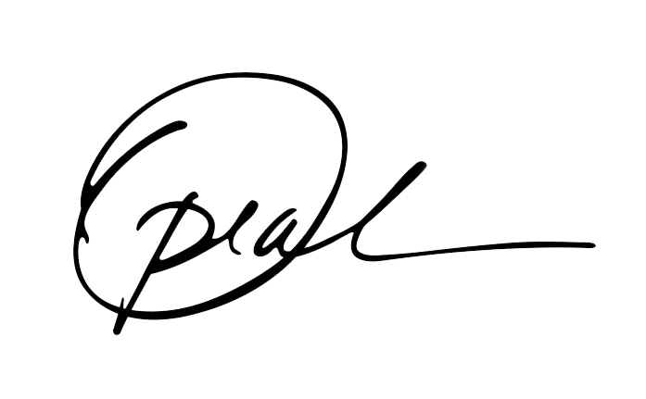
Oprah!

Slide 18
Reflect:
When could you journal each day?
Gratitude Journaling

Slide 19
Celebration is...
Survival.

Slide 20
Celebration is...
Survival. Strength.

Slide 21
Celebration is...
Advocacy.

Slide 22
How do you advocate?
What do you do to advocate for your program?
In your opinion, what is advocacy?

Slide 23
What is one of our biggest advocacy resources?
Our Students!

Slide 24

We need to open our doors!

Slide 25
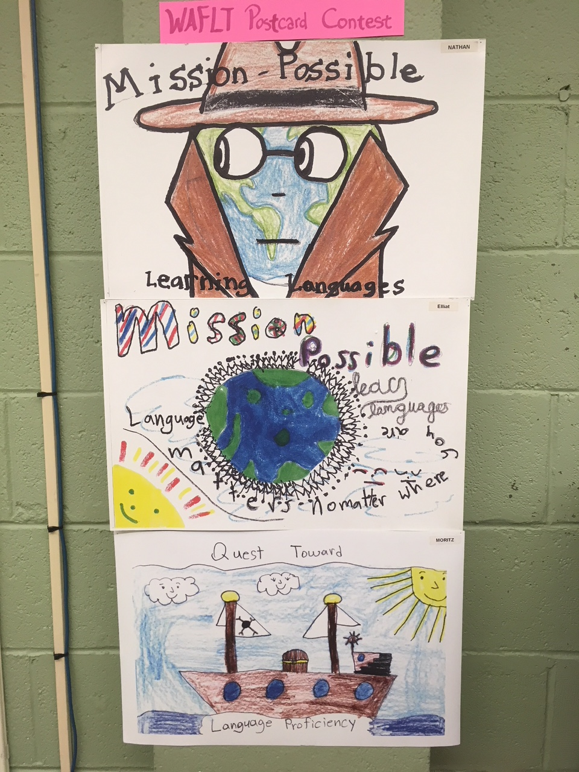
WAFLT Postcard Contest
First few weeks of school.
Helps address the “Why do you take a world language?” at the younger levels.
Create a display, make a big deal out of it! Show the community your involvement.

Slide 26
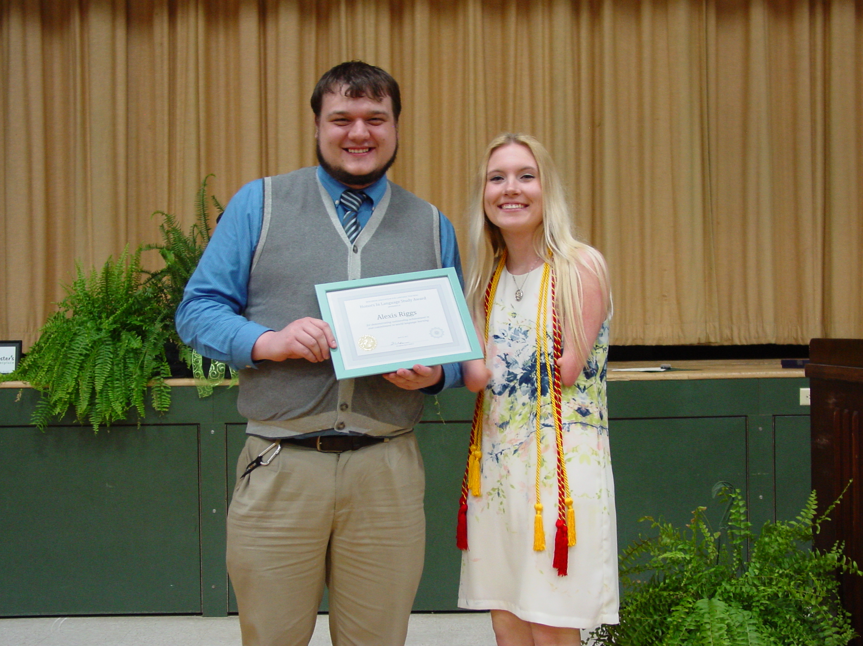
WAFLT Honors and Excellence in Language Study Award
Nominations Due March 15th!
Honors: Student in the highest level class
Excellence: Student with great potential in any level (including Elementary!)
Make the award known (newsletters, award nights, newspaper). Show a commitment to excellence to the community.

Slide 27

Focus on the “Can do’s”, not the “Can’t do’s”
Use student friendly “Can do” language
ACTFL/NCSSFL resource for all levels
Gives students tangible benchmarks to celebrate and share.
Puts language learning into words that families and admin can understand.

Slide 28
Reflect
What is one simple way that you can incorporate an aspect of celebration into your classroom in order to build a culture of advocacy?

Slide 29
Celebration highlights...
Growth.

Slide 30
Celebrating Growth
What do you do to celebrate growth and achievement in your classroom?

Slide 31
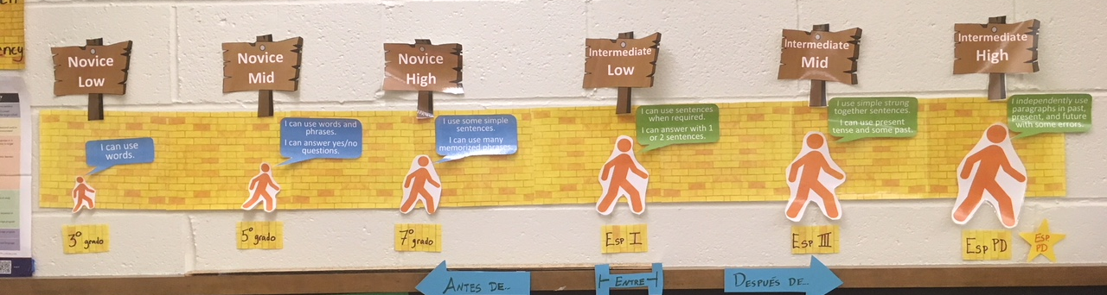
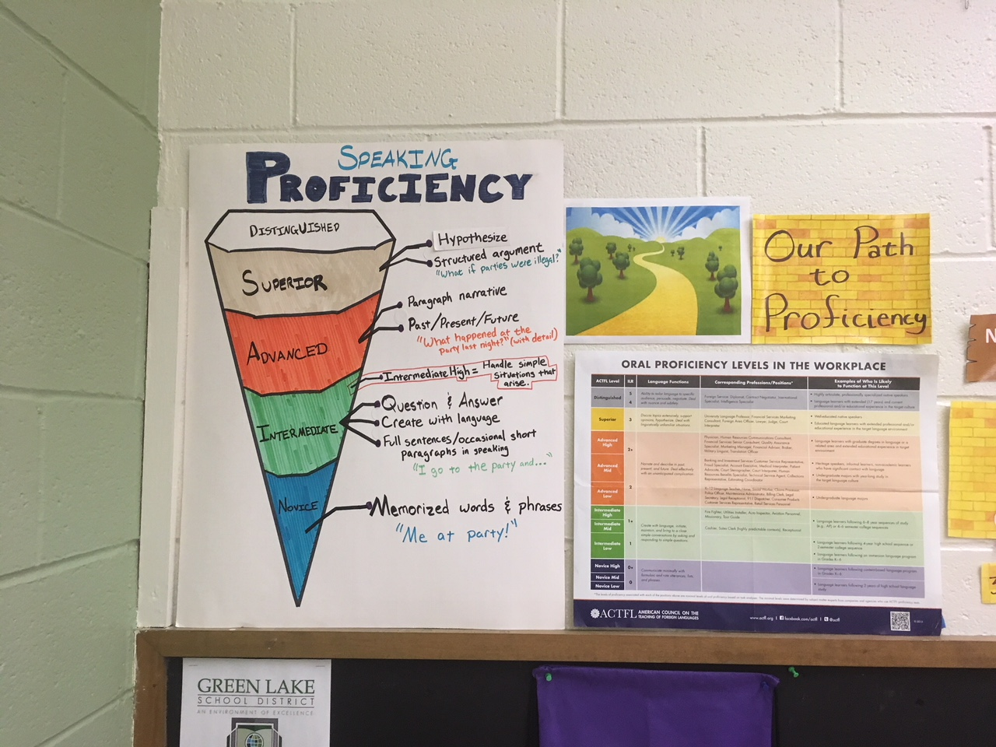
My journey…
Shifting the paradigm to proficiency.
Some had difficulty adjusting.
Transparent and for the students.
Here are my next steps…

Slide 32
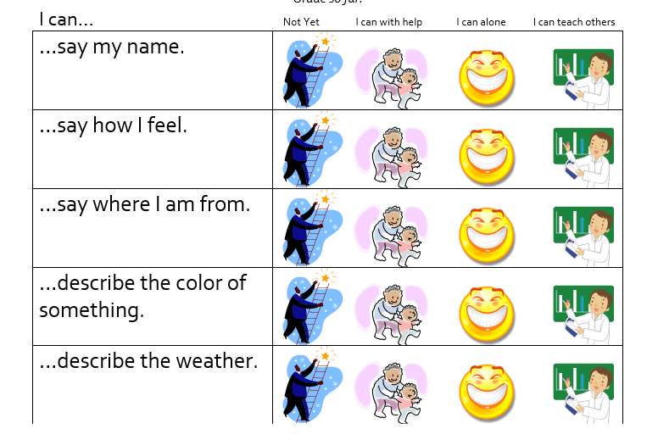
1 - Student
Friendly Rubrics
Help promote self-monitoring
Teach students to see own growth
Allow for “self-celebration”
*Disclaimer: Rough, rough draft from previous years

Slide 33

2- Implementation of affirmations
Provide system to regularly give feedback and allow students to be affirmed
Will use my creation from Make and Take this afternoon to house my affirmations
Students can take as they see fit in order to celebrate whatever growth they see

Slide 34


Step 3:Independent
Data!
?
Ultimate celebration after building a proficiency based program
Celebrate growth, while looking for areas to continue to grow
Give clearly documented evidence of program achievement to stakeholders
?

Slide 35
Celebrating Growth
What is something you can still implement this year to help promote self-monitoring/celebrating growth in your classroom?

Slide 36
Now’s the time
for us to celebrate.

Slide 37
BreakoutEDU
To celebrate FLESFEST’s 30th Anniversary, we are going to do a Breakout!

Slide 38
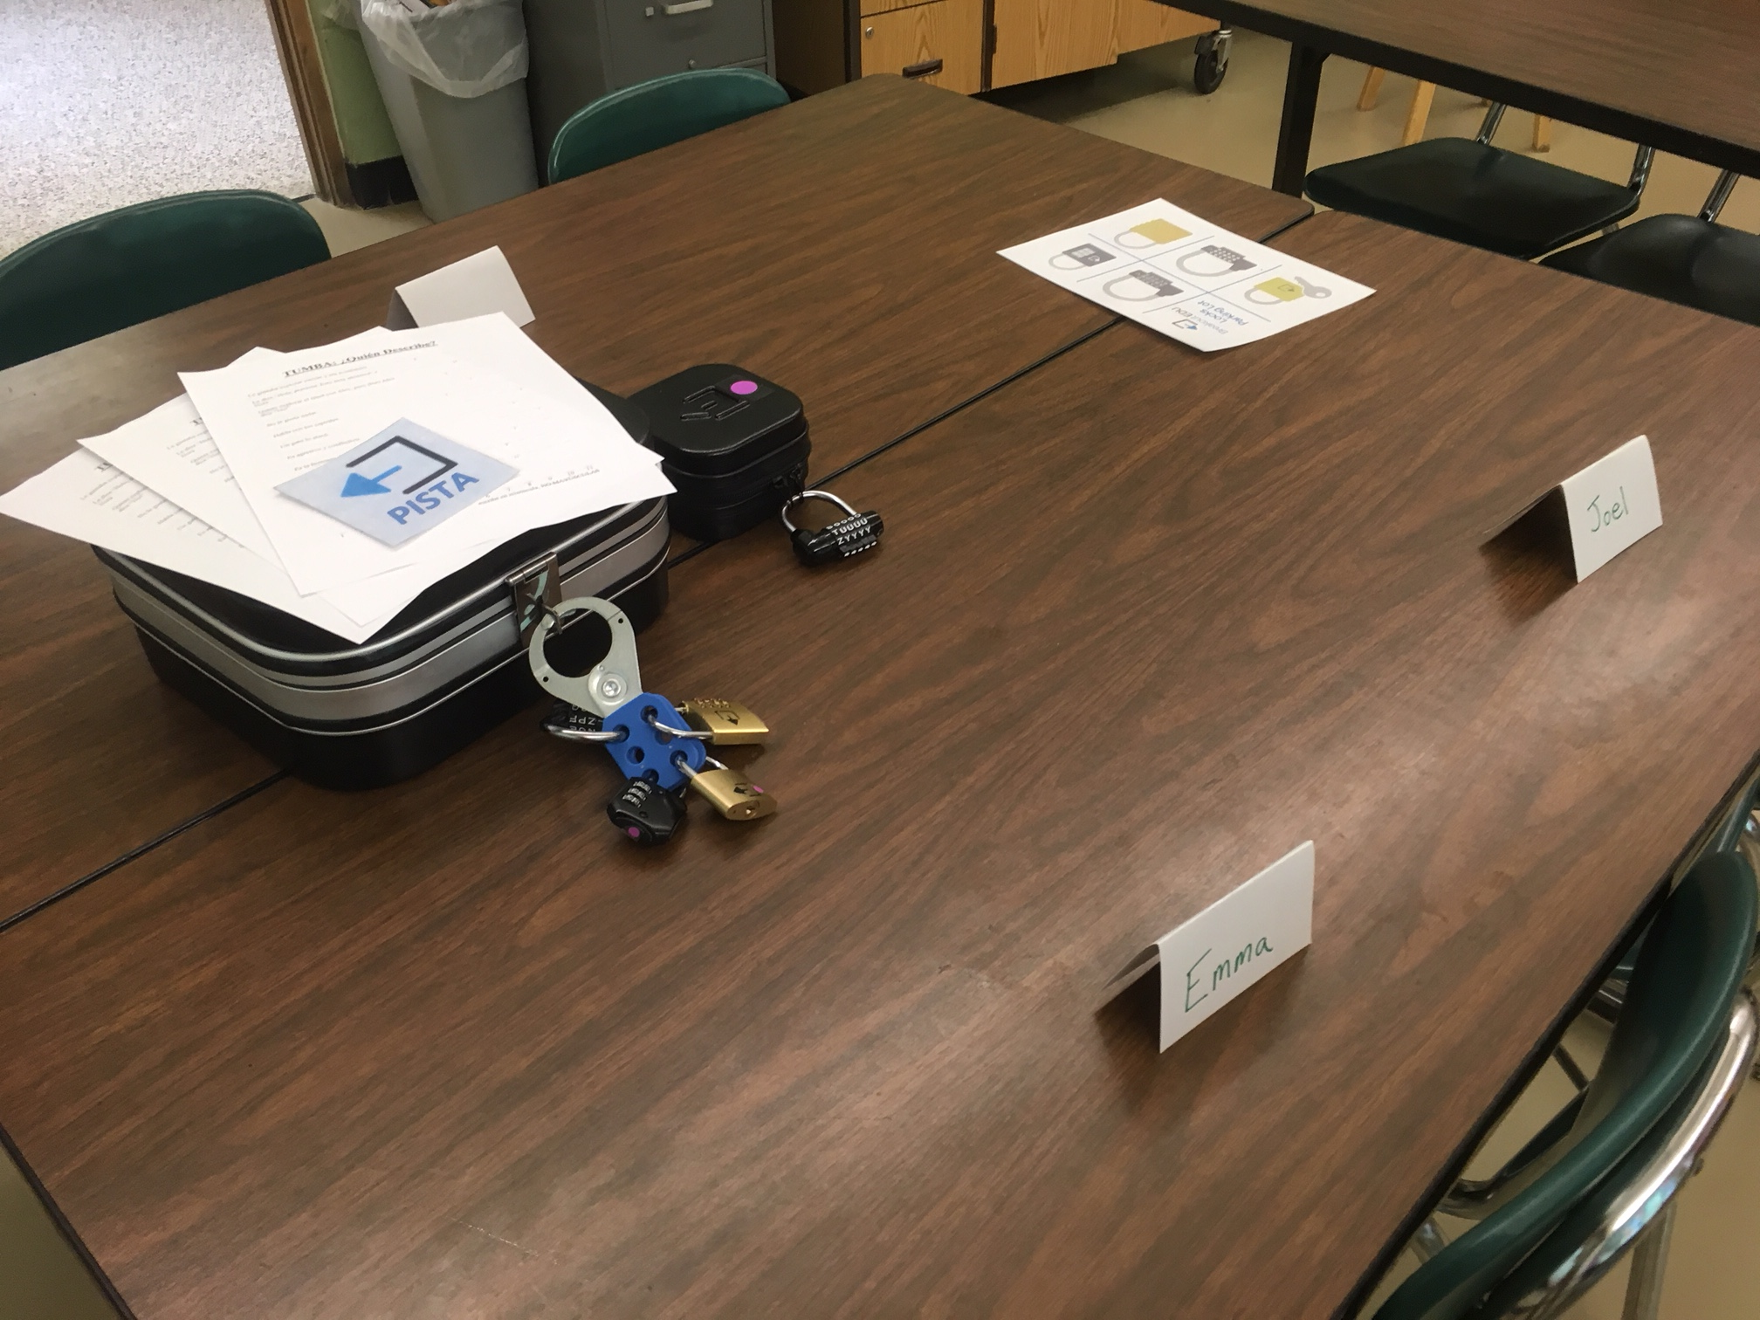
What is a Breakout?

Slide 39
Why I love Breakout Edu!
1) Critical Thinking
Students stretch their critical thinking skills while solving clues and making connections.
2) Adaptable to subject areas
The versatility of clues allows Breakout Edu to be used in all subject areas.
3) Challenge
Students learn to persevere as they tackle clues and work to open the Breakout box.
4) Communication skills!
Students must communicate well together in order to breakout in time.
5) Kids love it!
The desire to breakout maintains motivation and engages kids in teamwork and content.
6) Inquiry and Inference
Through natural curiosity, students practice making inferences to solve clues.

Slide 40
The never- ending Keynote
Breakout to release the final slides and finish the Keynote!

Slide 41
Let’s Breakout
You have already been randomly divided into groups:
Look at the bracelet you made – the color of the pipe cleaner is your group.
Listen for your color and group leader.
When you get together, you will find a large locked box, a small locked box, and a few documents in a file folder.
Examine everything!
You are allowed to use technology if needed.
You get two hint cards. You have 25 minutes.

Slide 42
Did you Breakout?
In your groups, reflect on the following:
What were you able to contribute to your group in solving this puzzle?
What puzzles did you find the most difficult?
How did your group work well together?
What did playing this game tell you about yourself and your teammates?
How might you use this in your classroom?

Slide 43
“Although it may appear paradoxical, celebrating what’s right also allows us to harness the energy we need to fix what’s wrong with the world—or at least our corners of it. Celebrating what’s right with the world does not mean pretending there aren’t things that are wrong. Without a doubt, many situations desperately need improvement…

Slide 44
However, we are more prepared to tackle these tasks when we can also keep in mind the many things that are right with the world. When we recognize the good, we’re implicitly acknowledging that solutions exist for many of the challenges before us.”
-Dewitt Jones

Slide 45
As we go through today, take time to celebrate.
Celebrate learning new ways to use books with Lynn.
Celebrate as you map out interpersonal novice speaking tasks with Jeanne and Carol.
Celebrate rediscovering how it feels to work at the novice level with Anita.
Celebrate wherever you are on the thematic unit journey with Lisa and Karen.

Slide 46
“Every day is a good day. There is something to learn, care, and celebrate.”
-Amit Ray
“In our work and in our living, we must recognize that difference is a reason for celebration and growth, rather than a reason for destruction.” -Audre Lorde
FLESFEST is 30
years strong thanks to
dedicated teachers like
you! Celebrate
yourself!
“The more you praise and celebrate your life, the more there is in life to celebrate.”
-Oprah
“Singing is like a
celebration of
oxygen.”
-Bjork

Slide 47

Thank You!
Let’s celebrate this day together!
You can find me at:
@joshlegreve
joshlegreve@gmail.com

